Slide 1
For sale : One snake. Good oil producer. No longer required.
Dr Ian Levy
Technical Director
National Cyber Security Centre

Slide 2
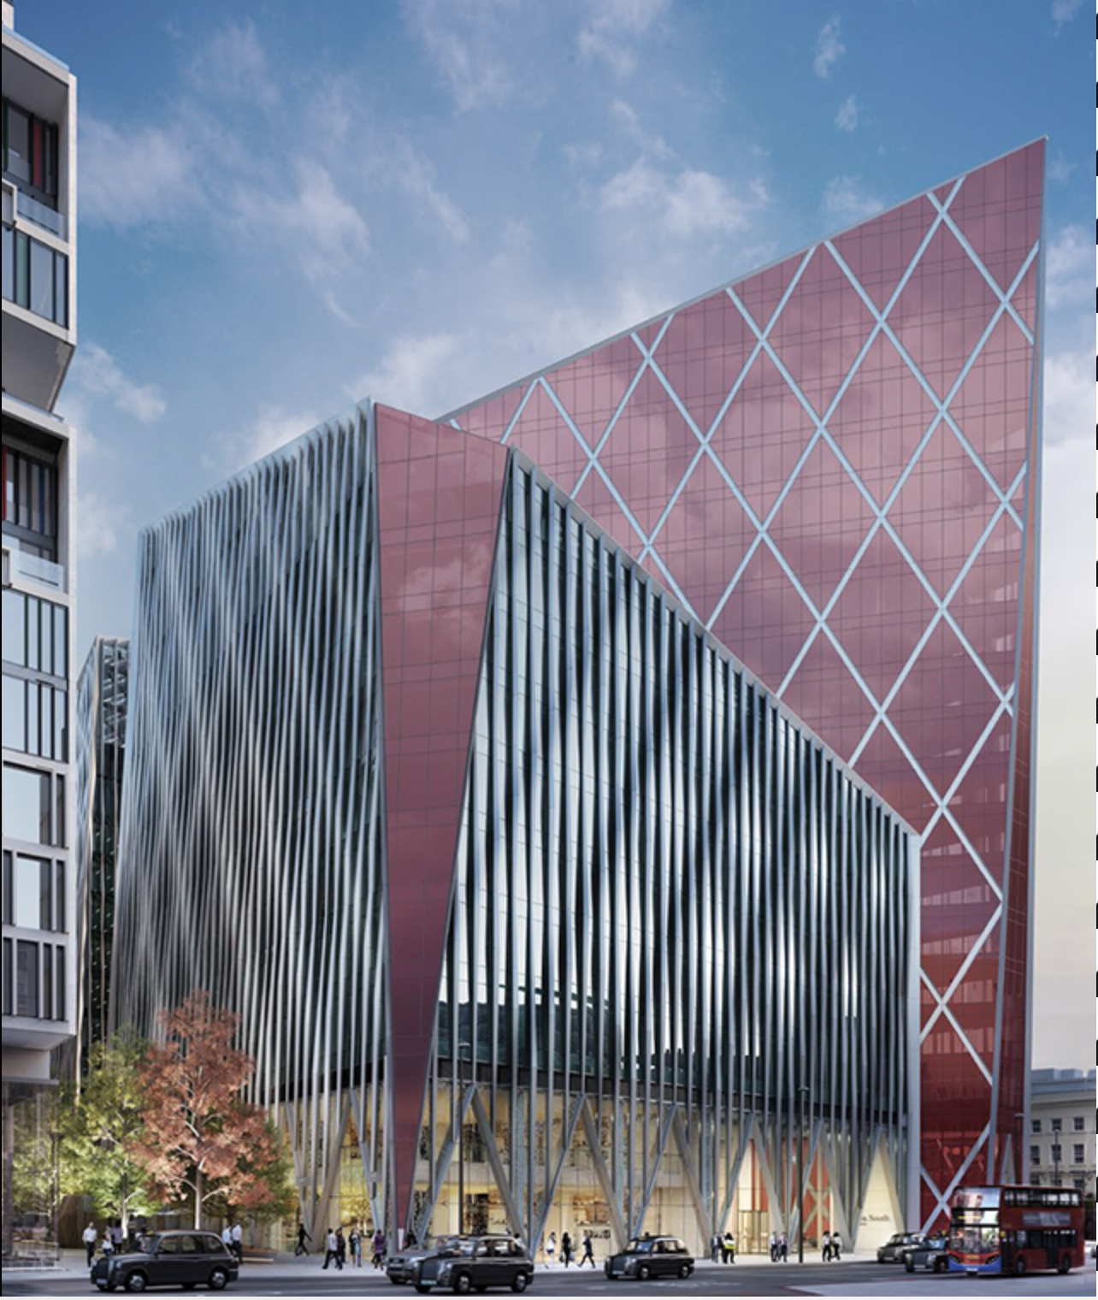
A Different Sort of Agency

Slide 3
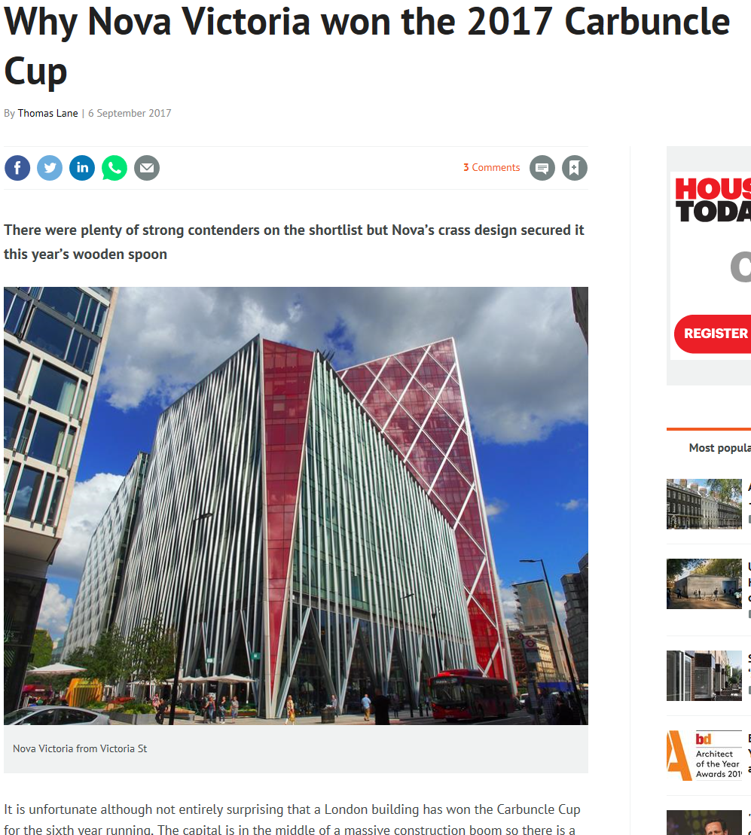
Early wins…

Slide 4
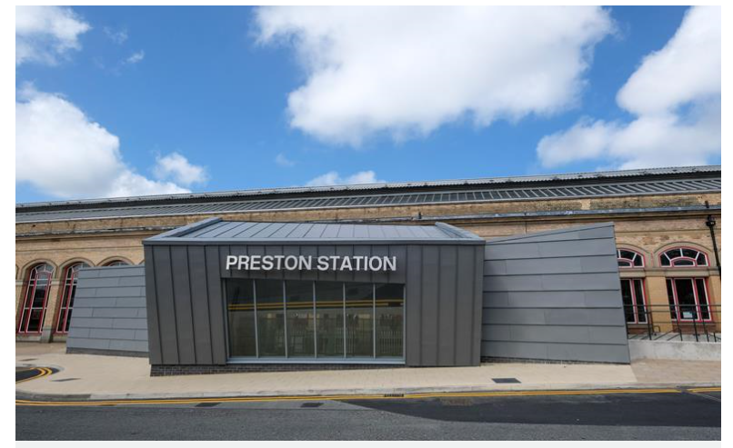
Know your competition…

Slide 5
Evidence driven policy

Slide 6
Simplify cybersecurity* to democratise it.
* Yes, I hate the C-word as well, but it’s what we’re stuck with.

Slide 7
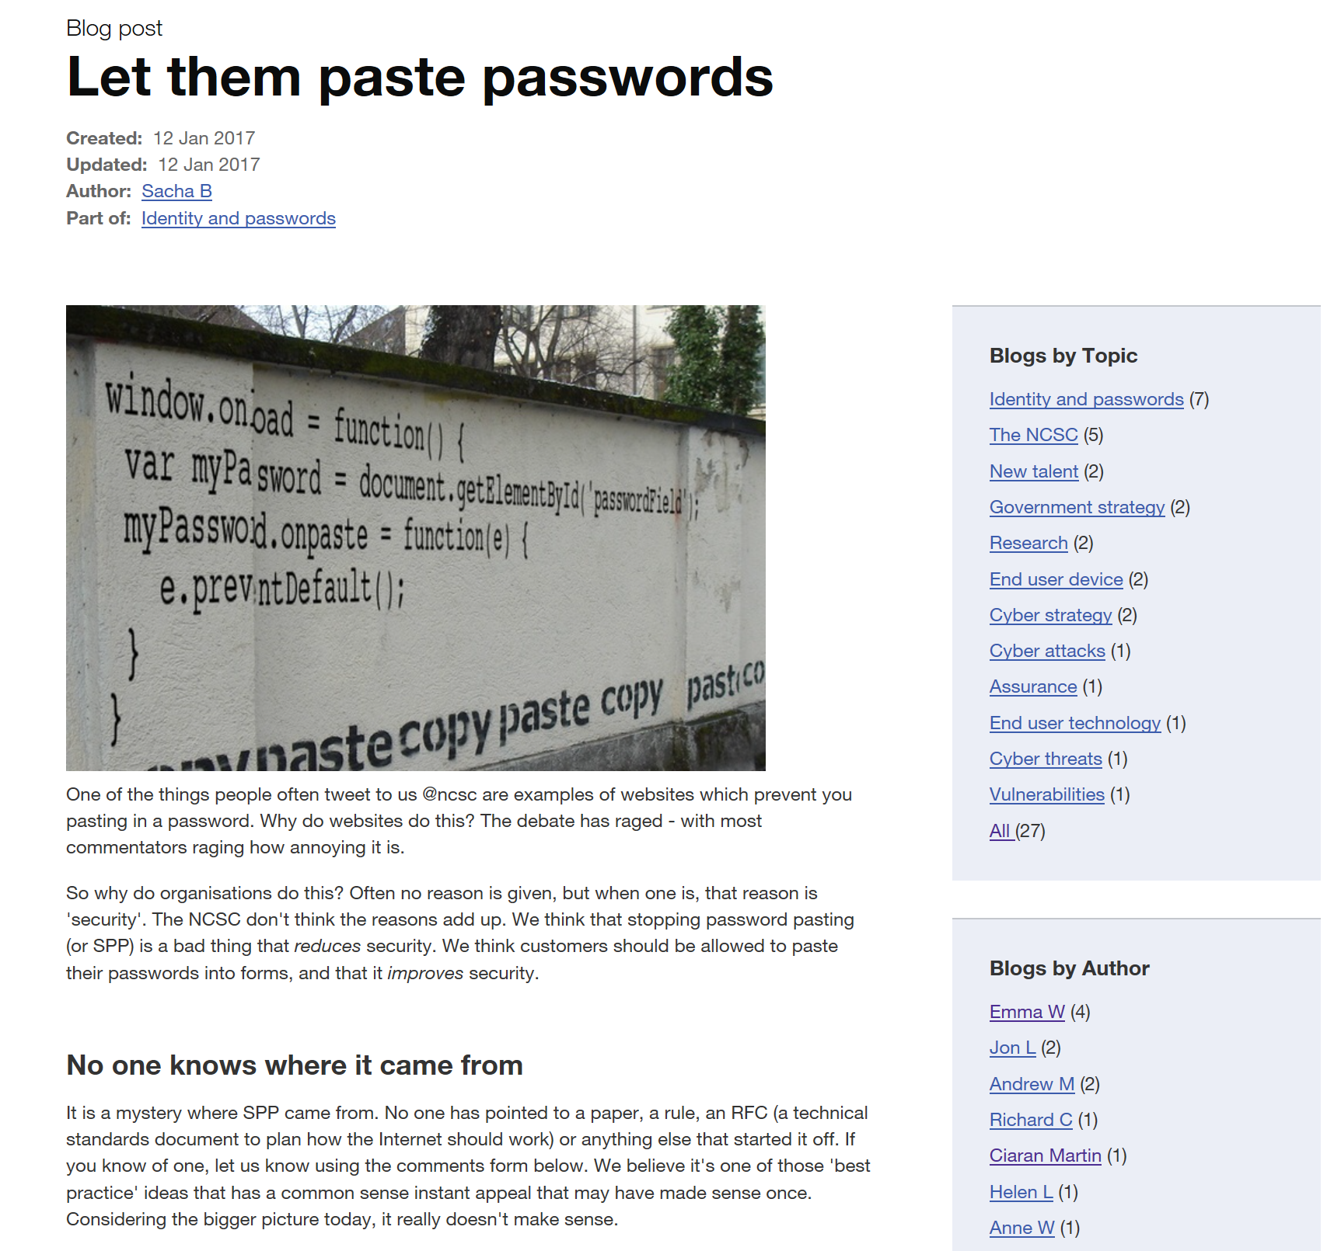

Slide 8
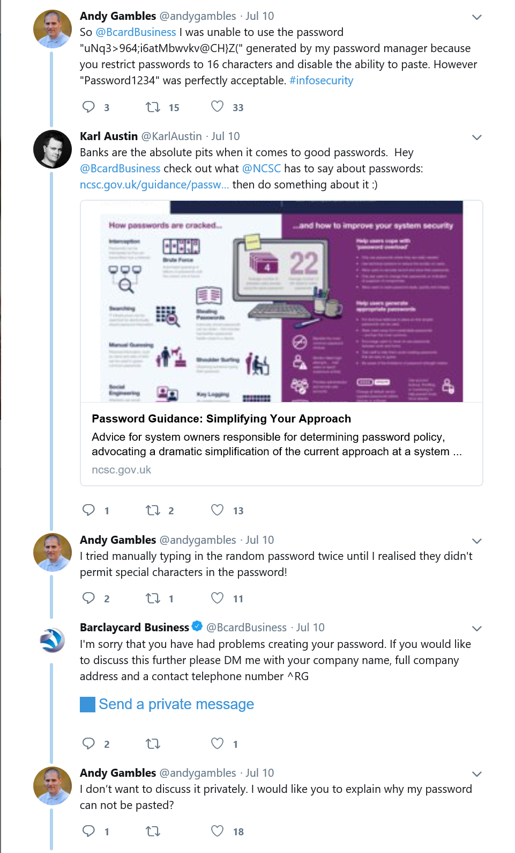
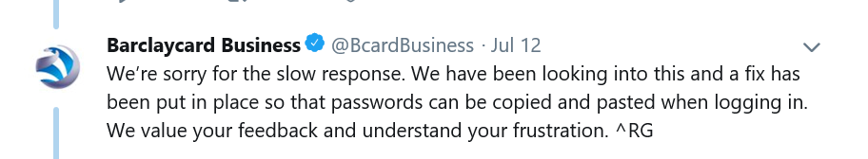
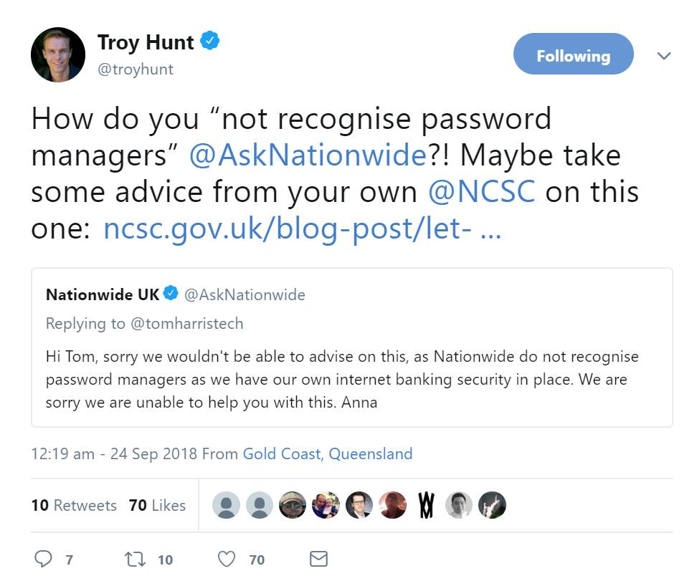

Slide 9
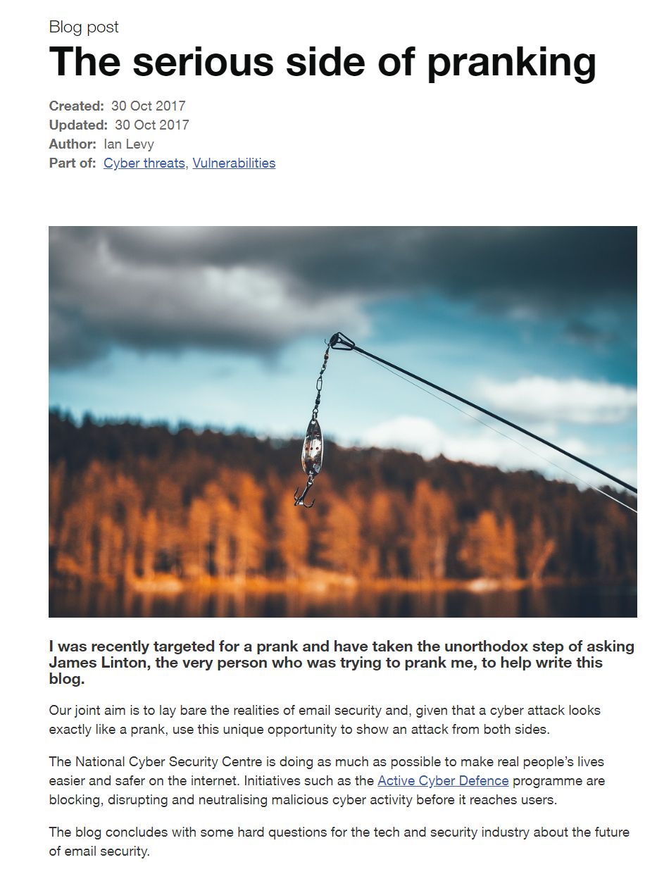
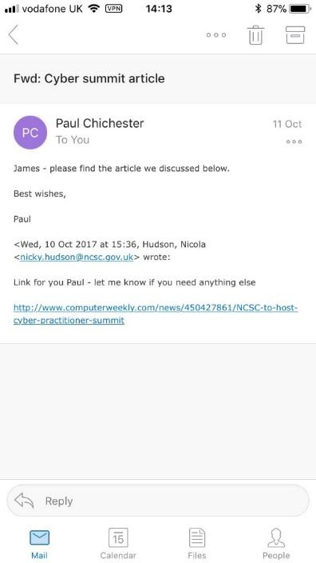
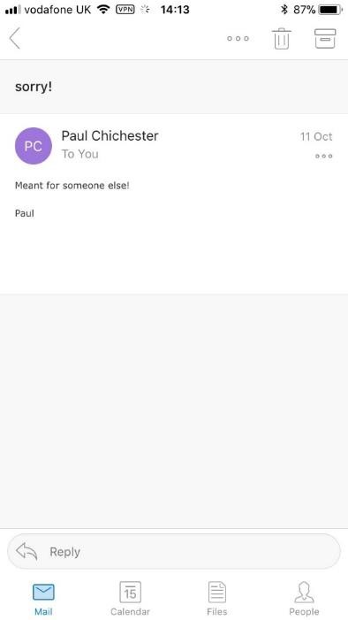

Slide 10
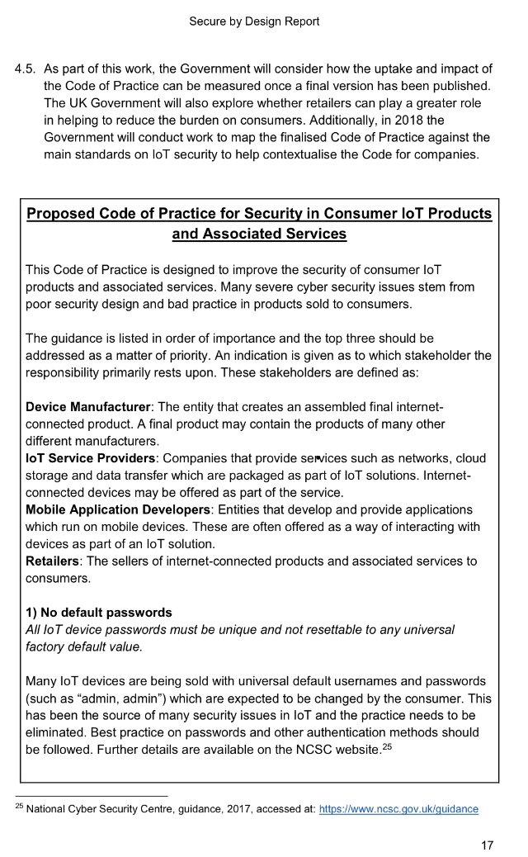
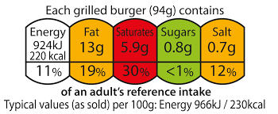
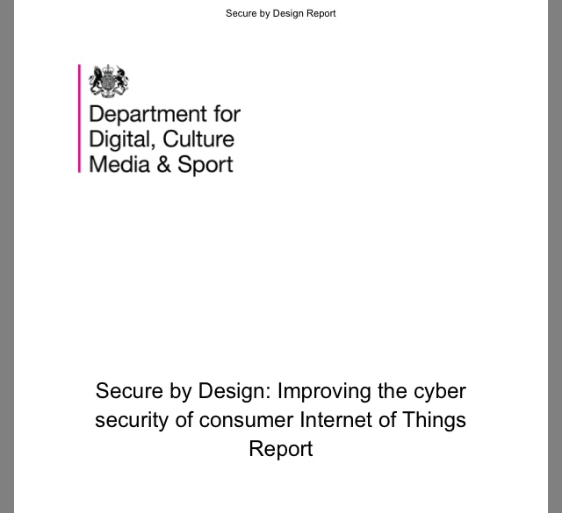

Slide 11
Protect the majority of the people from the majority of the harm caused by the majority of the attacks, the majority of the time.

Slide 12
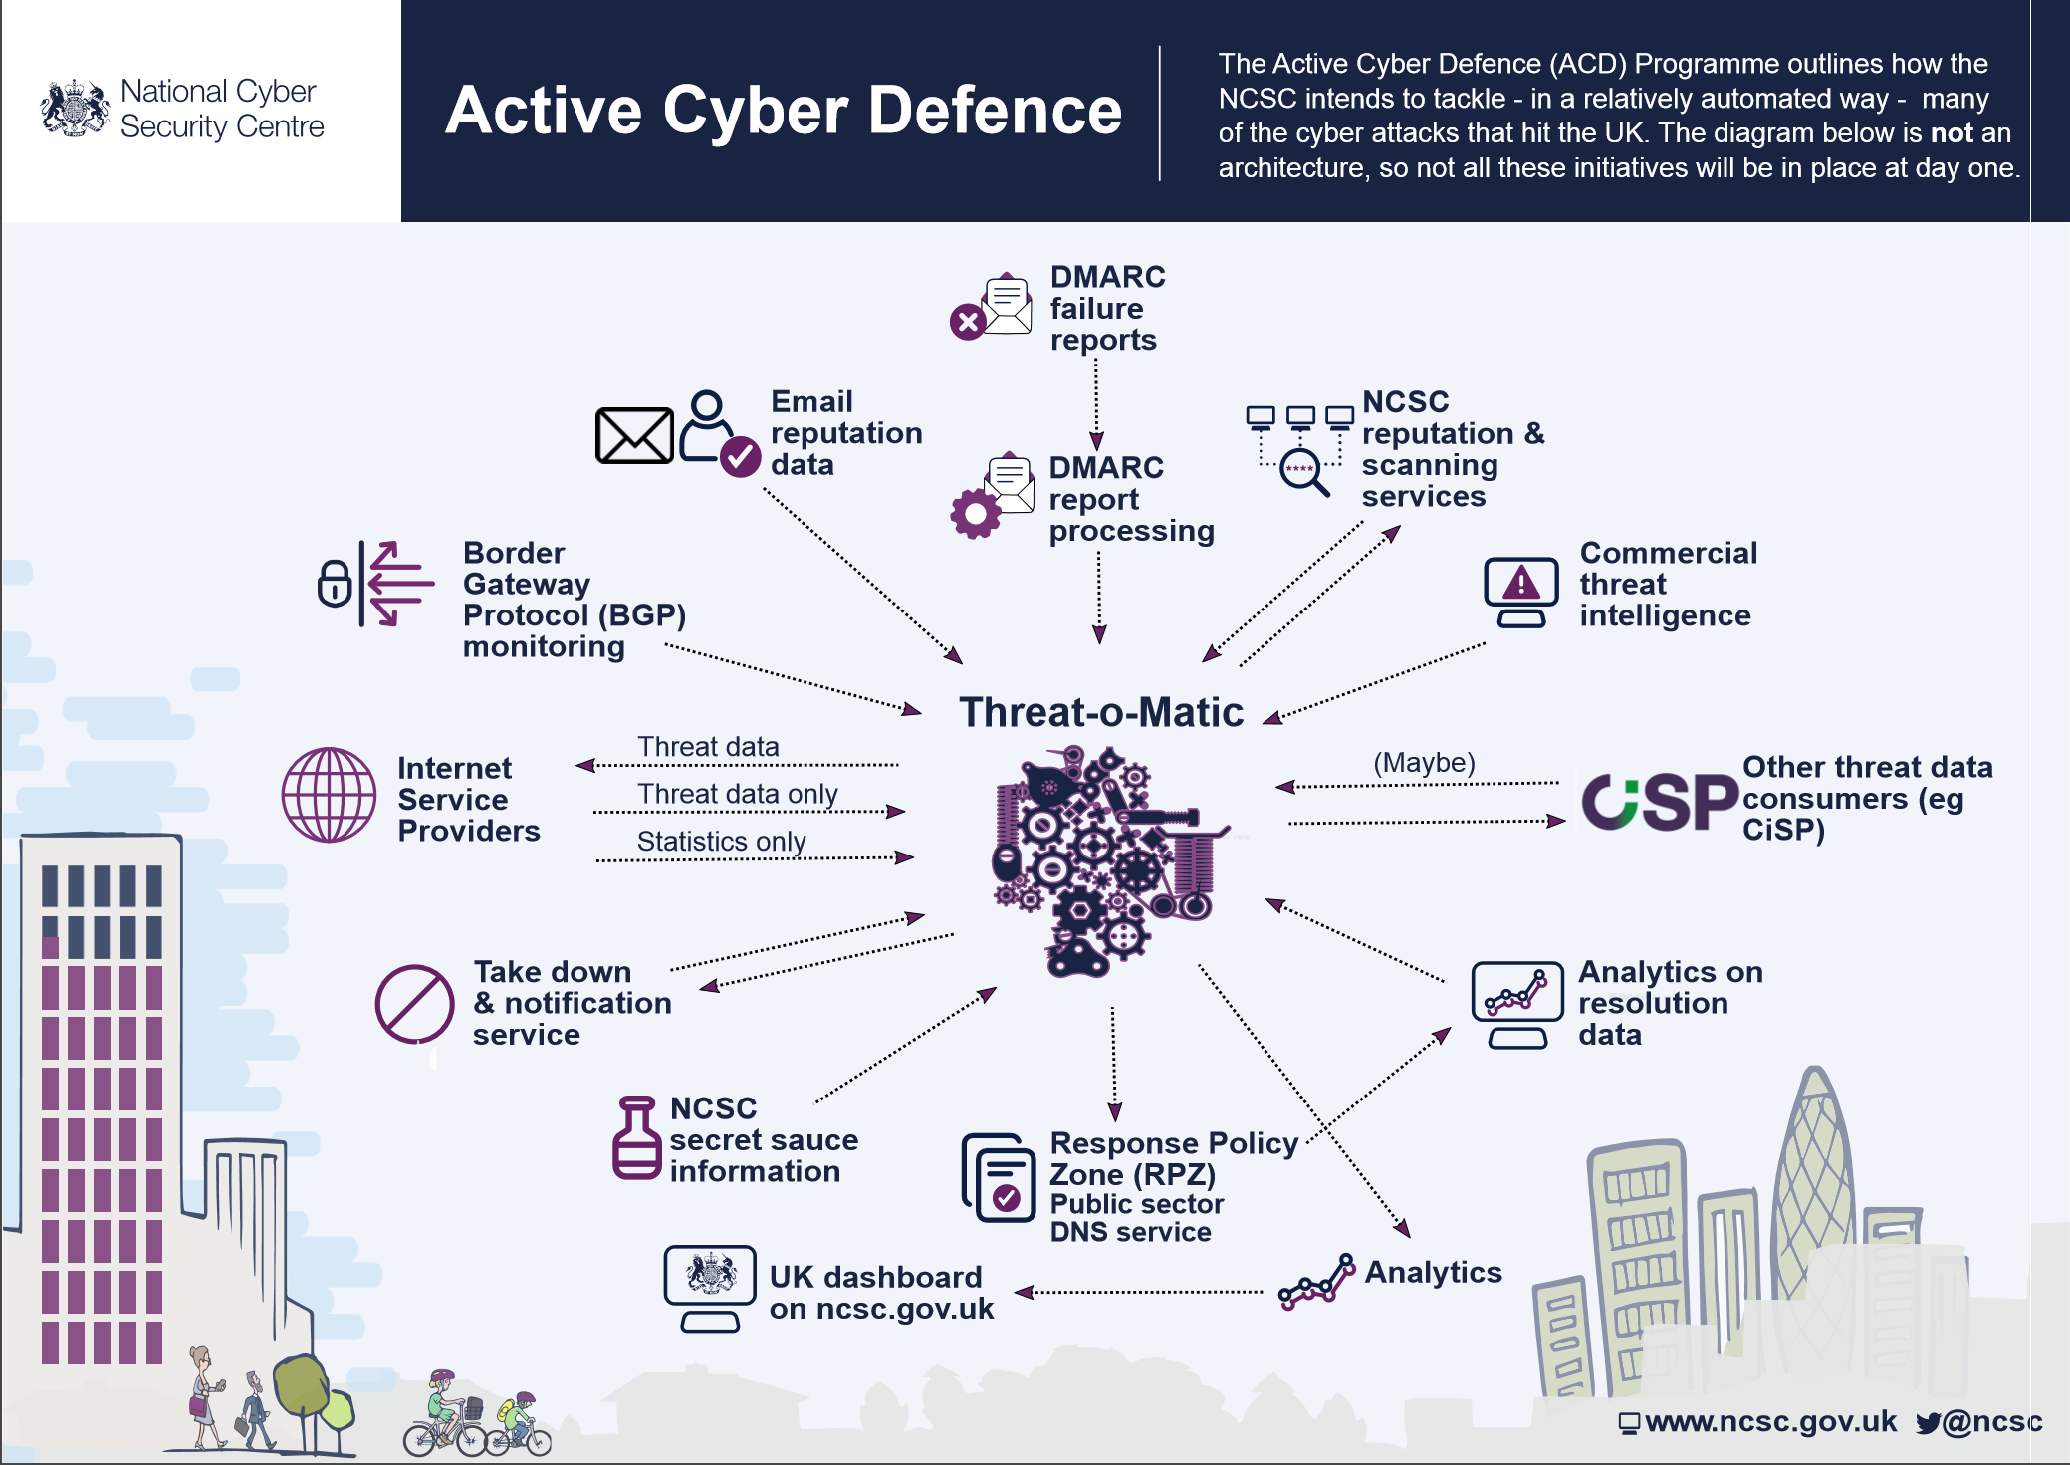

Slide 13
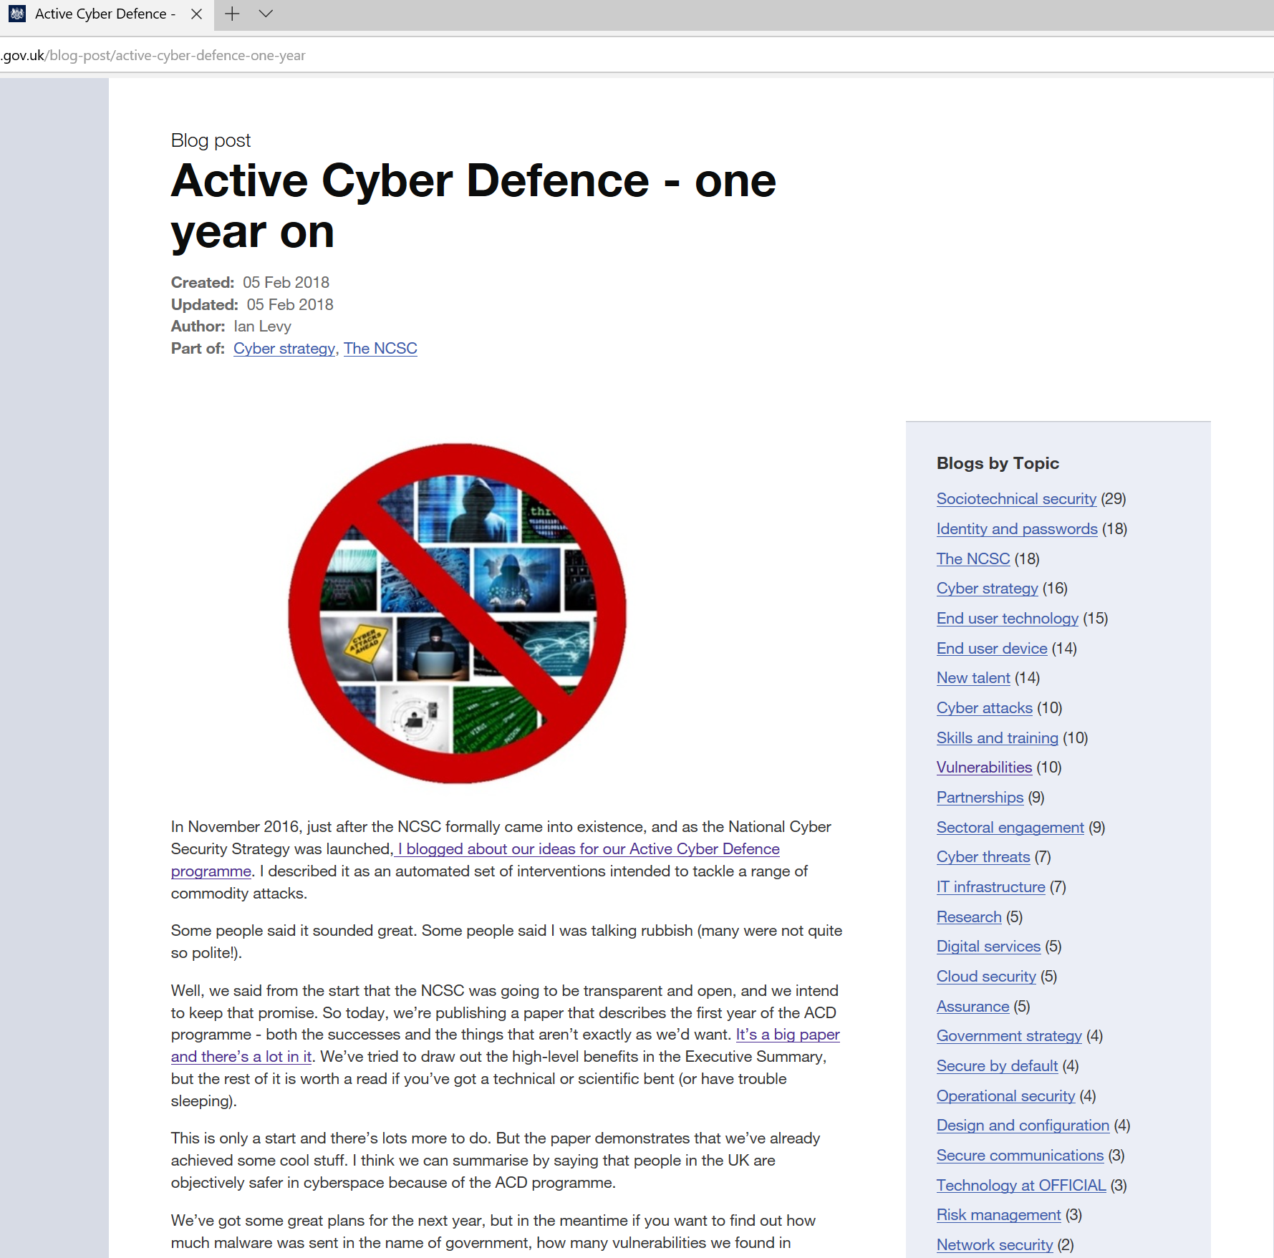

Slide 14
ACD by the numbers
DMARC: 572/1369/6974
Synthetic DMARC : 430k Aug-Nov 2018
HMRC: 16th to 146th

Slide 15
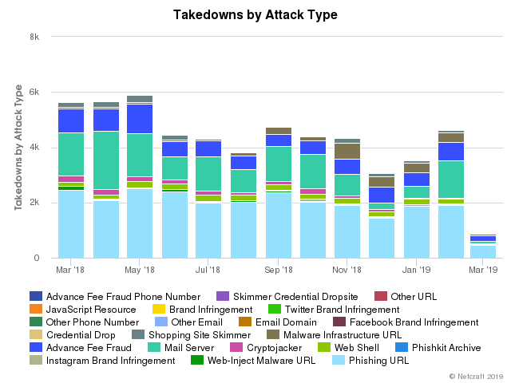

Slide 16
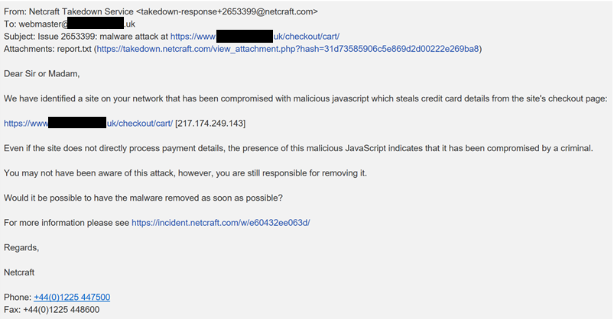

Slide 17
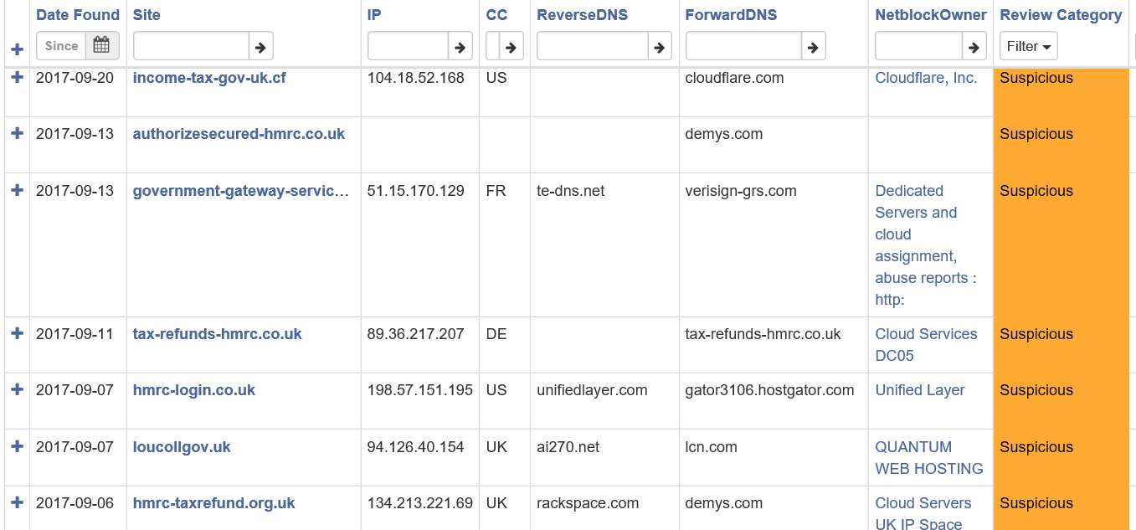

Slide 18
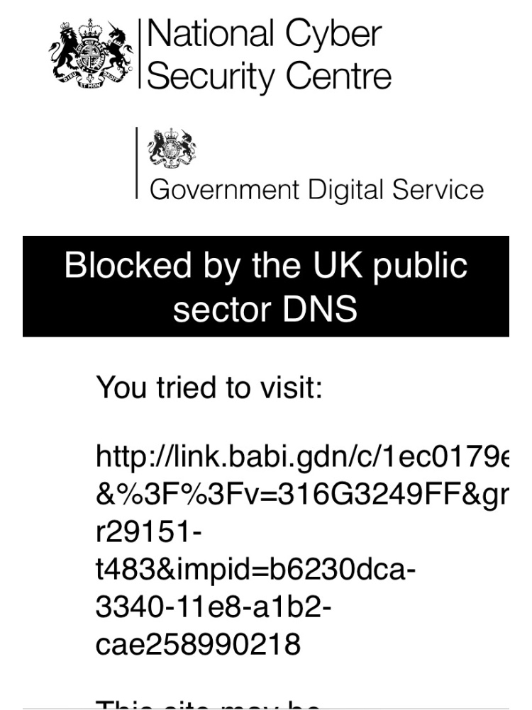
ACD by the numbers
25th Feb – 3rd March
4.6 billion,
~1 million, 1247

Slide 19
ACD by the numbers
In 2018, Public Sector Protective DNS:
Protecting about 1.4 million public sector employees
Blocked 57.4 million queries out of 68.7 billion for 118,527 unique blocks
Blocked 28 million queries related to 15 DGAs, including Conficker, Ramnit, Suppobox, Tiny Banker, Matsnu, Bedep, Fobber
Blocked 13,800 queries for specific botnet C2, including Betabot, Graybird, Katrina, Lokibot, StealRat, Godzilla
Blocked 796,000 queries related to exploit kits, including Magnitude, RIG, Sweet Orange, Neutrino
450,000 WannaCry related queries from 15 different departments
Around 20 APT-related things per week

Slide 20
ACD by the numbers
Other crap in the name of government we’ve cleaned up globally this year:
14,071 phishing URLs
44,608 Mail servers sending malicious attachments
4,107 Mail servers sending Advance Fee Fraud campaigns (419 scams)
1,984 Mail servers sending Phishing links
546 Malware distribution URLs
234 Malware Command & Control Centres
175 Malware Infrastructure URLs
75 Malicious Web Shells
Millions of spoofed emails

Slide 21
ACD by the numbers
27 hours to 1 hour
138,587

Slide 22
ACD by the numbers
5.3% (6/16) to 2.1% (12/18)

Slide 23
ACD by the numbers
Other crap we’ve cleaned up in UK delegated IP space :
1,581 Non-consensual Monero Miners
2,311 Malicious Web Shells
2,156 Web-Inject URLs
2,333 Credit Card Skimmers attached to website shopping carts (3 months)

Slide 24
Scaling : ISPs
BT : 6 million residential customers.
135 million malware C2 blocks/month

Slide 25
>1500

Slide 26
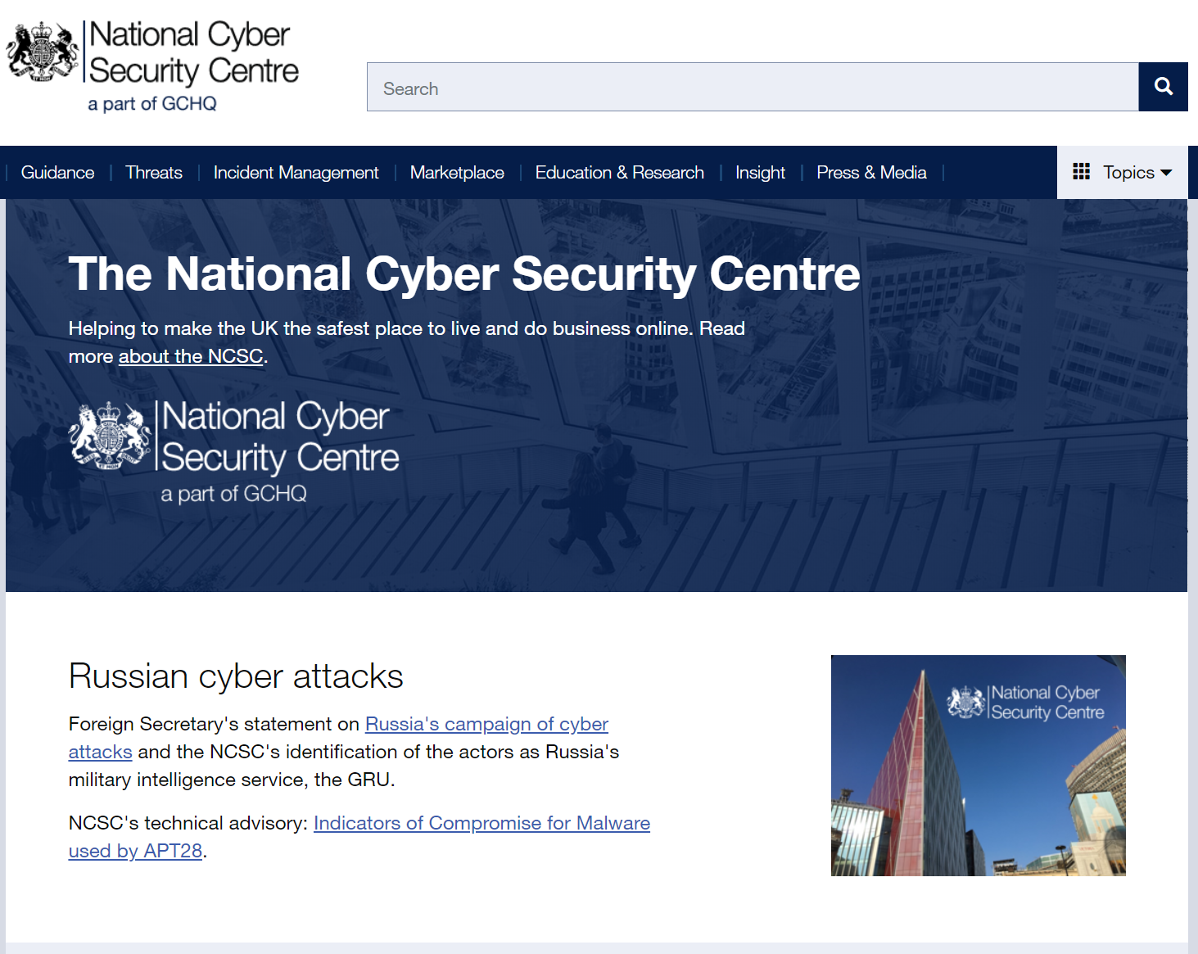

Slide 27
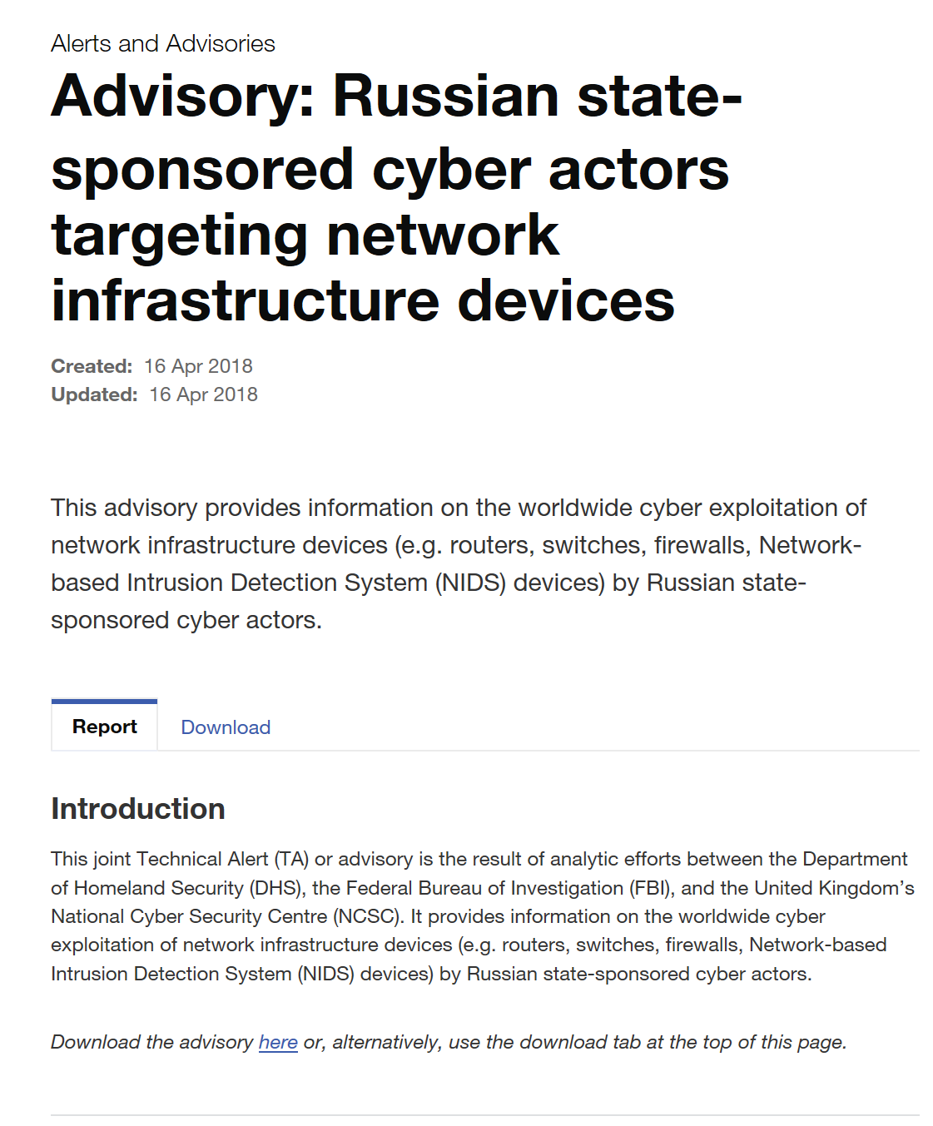

Slide 28
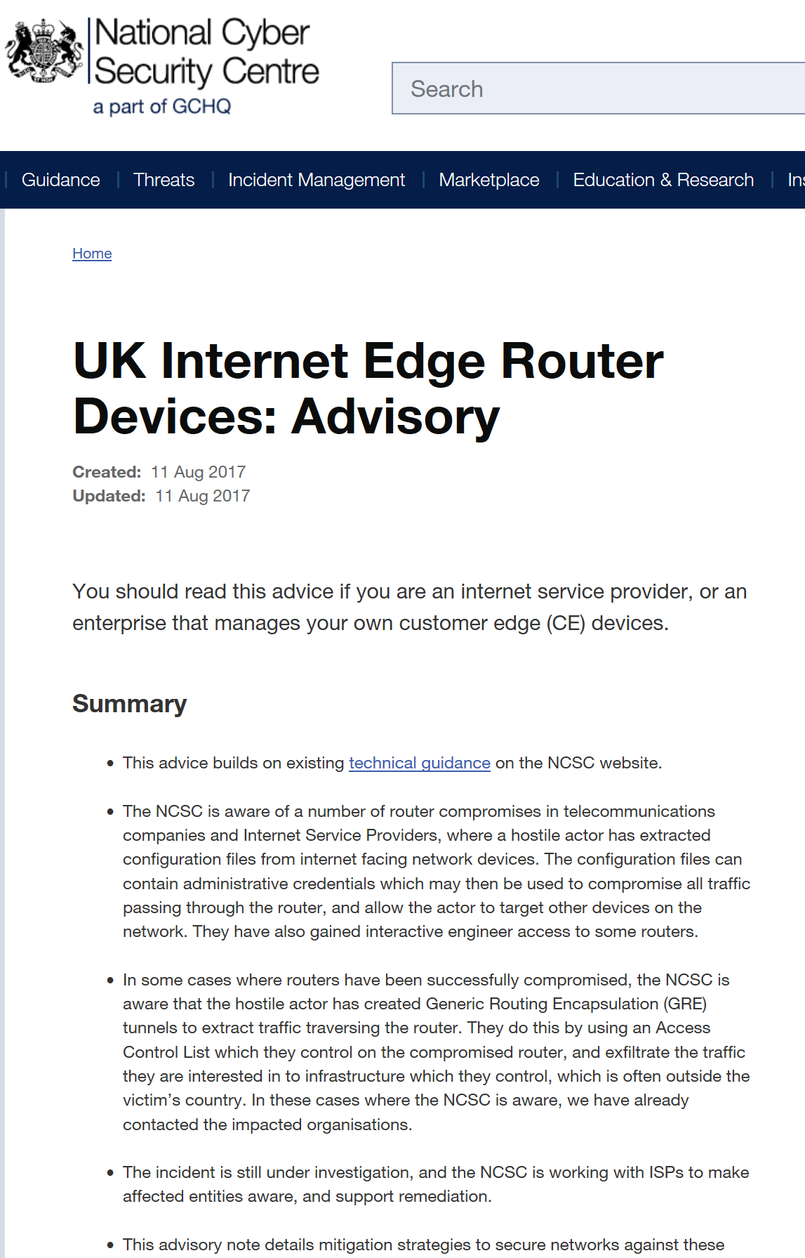
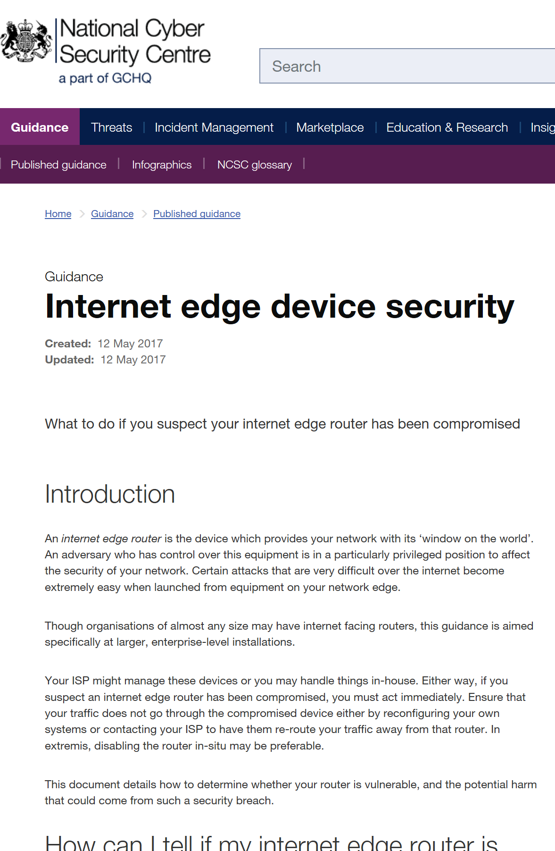

Slide 29


















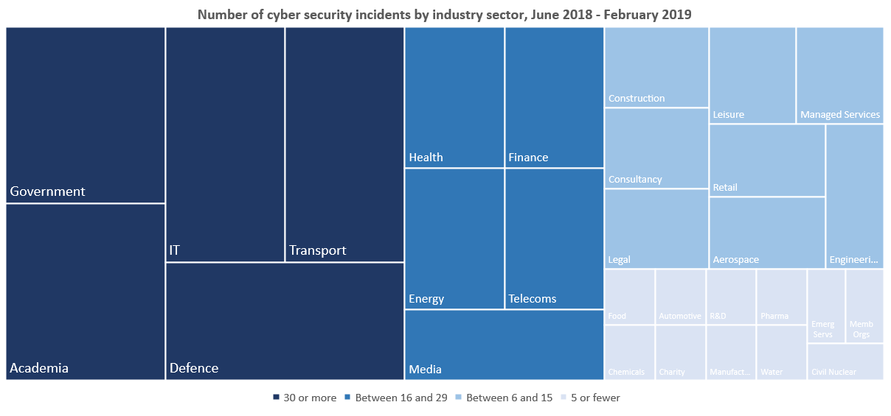

Slide 30
It’s not all 0-day wielding nation states

Slide 31
If your administrators browse the web or get email using their admin machine or account, you’re too stupid to help.

Slide 32
What’s connected to your external IP ranges and who’s responsible for looking after it?

Slide 33
Creds matter.

Slide 34
Why SMART?

Slide 35
Security being baked in to protocols.
Designs need to be cognisant of *actual* attacks

Slide 36
People are increasingly part of protocols

Slide 37
Bad guys can use the shiny too

Slide 38
Adversaries are not passive

Slide 39
Security != encryption

Slide 40
Side-effects can scale badly from a defence point of view

Slide 41
Need to make sure that we don’t enable new attack modalities
Security != Privacy != Resilience

Slide 42
Questions?

